Slide 1
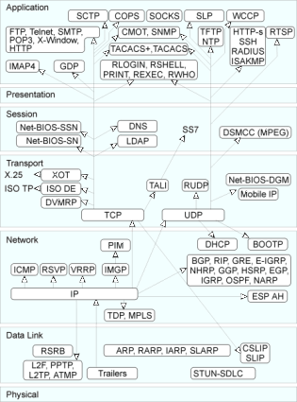
http://www.protocols.com/

Slide 2
A datagram is an independent, self-contained message sent over the network whose arrival, arrival time, and content are not guaranteed.
The java.net package contains two classes to help you write Java programs that use datagrams to send and receive packets over the network:
1. DatagramSocket , DatagramPacket : An application can send and receive DatagramPackets through a DatagramSocket.
2. MulticastSocket: In addition, DatagramPackets can be broadcast to multiple recipients all listening to a MulticastSocket.

Slide 3
Request for a quotation
client
server
handler
“ciao”
ciao

Slide 4
Multicast Groups and Addresses
Every IP multicast group has a group address.
IP multicast provides only open groups: That is, it is not necessary to be a member of a group in order to send datagrams to the group.
Multicast address are like IP addresses used for single hosts, and is written in the same way: A.B.C.D. Multicast addresses will never clash with host addresses because a portion of the IP address space is specifically reserved for multicast. This reserved range consists of addresses from 224.0.0.0 to 239.255.255.255.
However, the multicast addresses from 224.0.0.0 to 224.0.0.255 are reserved for multicast routing information; Application programs should use multicast addresses outside this range.

Slide 5
client
server
“ciao”
client
handler
ciao
client
MulticastServerThread is a subclass of QuoteServerThread so that it can use the constructor, and inherit some member variable and the getNextQuote method.

